Slide 1


Section 8.4 Interviews
By: Elizabeth Dayton
4 types of interviews:
Open-ended (unstructured)
Structured
Semi-structured
Group Interviews (focus groups)
Notes:
Determining approach includes the purpose of the interview, what questions you want to ask, and the interaction design activity

Slide 2
8.4.1 Unstructured Interviews
These are similar to a conversation
Benefits:
Can lead to issues that the interviewer hadn’t considered before
These interviews create complex, rich data
Drawbacks:
These interviews will vary widely with every participant
They also take a much longer time to analyze
Notes:
Interviewers have a set list of broad topics to cover, but usually ask follow-up questions to answers given (probing)

Slide 3
8.4.2 Structured Interviews
Consists of predetermined questions and answer options (similar to questionnaires)
Benefits:
Can be analyzed much faster as every participant can only answer from a given set of answers
Drawbacks:
Some answers may not reflect every possible option someone might want to select and so might have less accurate information

Slide 4
8.4.3 Semi-Structured Interviews
This is a blend of structured and unstructured interviews
Different Kinds of Users:
People from different cultures need different approaches to questions and use cases
If children are users as well, it’s important to make them feel safe while you ask them questions and that your mood or facial expression doesn’t influence their answers
Notes:
It’s important when conducting the unstructured part of the interview that you don’t lead the user to answer a specific way

Slide 5
8.4.4 Focus Groups
Normally consists of 3-10 people who represent the collective target audience with a facilitator
Benefits:
Can discover conflicting expectations
Allows diverse or sensitive issues to be raised that otherwise might have been missed
Notes:
The cultures of the people being interviewed is also important here in case there is a cultural rule for speaking in groups

Slide 6

8.4.5 Planning & Conducting an Interview
Develop a set of questions or topics
Any documentation needed (like a consent form or project description)
Checking recording equipment
Structuring the interview
Finding a suitable time and place

Slide 7
8.4.5 Planning & Conducting an Interview
Developing Interview Questions:
Open questions are best when the goal is exploratory
Closed questions are best when the possible answers are known in advance
Make large open questions as simple as possible
Avoid jargon or complex language
Keep questions neutral
Notes:
If necessary, split large, complex questions into smaller ones
Keeping them neutral ensures you don’t lead them to answer a certain way

Slide 8
8.4.5 Planning & Conducting an Interview
Running the Interview:
Introduce yourself and give reasoning for the interview (also ask permission to record if necessary)
Start with easy questions like demographics
Leave more probing questions for towards the end
A cooling-off period with more easy questions
Closing session featuring a thanks and a turning off of equipment and/or putting away any written material

Slide 9
8.4.6 Other Forms of Interview
Using a digital conferencing tool:
Benefits:
Participants are in their own environment and are more relaxed
They don’t have to travel, nor worry about what they’re wearing
For interviews involving sensitive topics, they can more easily remain anonymous using voice only
A wider range of participants can be reached
Drawbacks:
Interviewer might miss body language

Slide 10
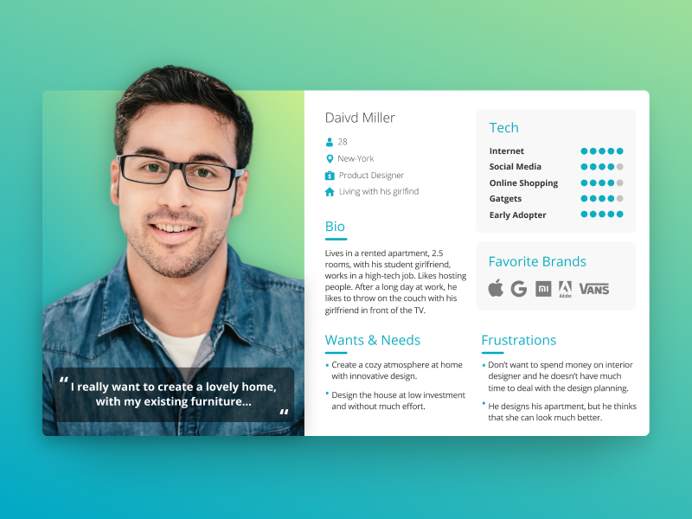
8.4.7 Enriching the Interview Experience
Participants are often in a new environment that’s out of their comfort zone
Can be difficult to get full answers
How do you solve this?
Props such as persona prototypes and work artifacts can be brought along to help make them more comfortable

